Slide 1
Electromechanical Subsystem
Huzeyfe Hintoglu

Slide 2
Outline
Mechanical Design
Actuator System Design

Slide 3
Mechanical Design
Objectives&Requirements
Light and Compact Design
Neatness
Durability (Mechanically)
Inexpensive

Slide 4
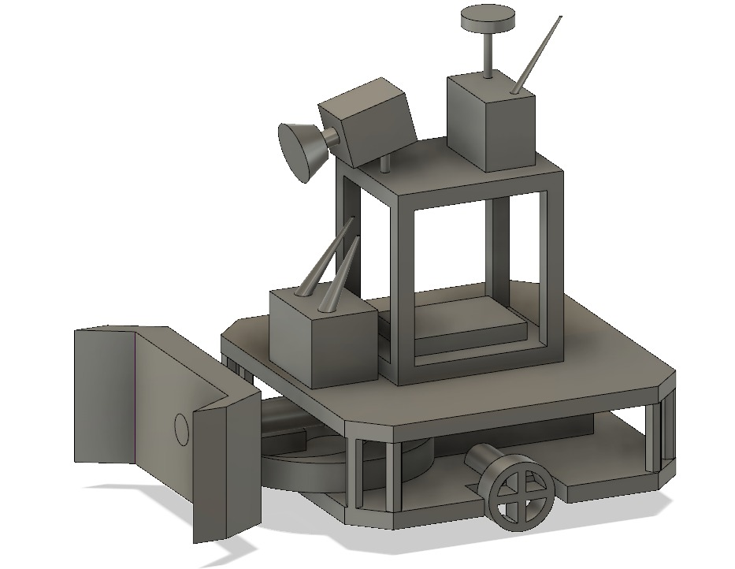
Mechanical Design

Slide 5
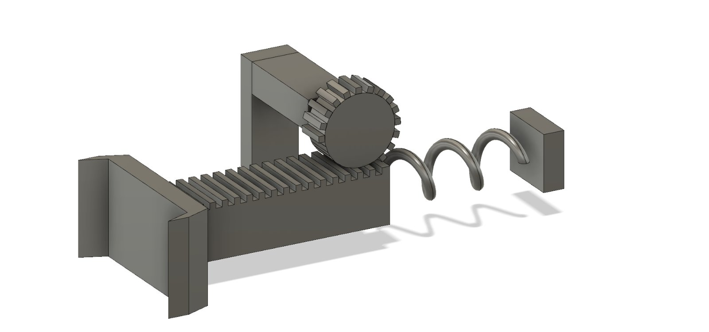
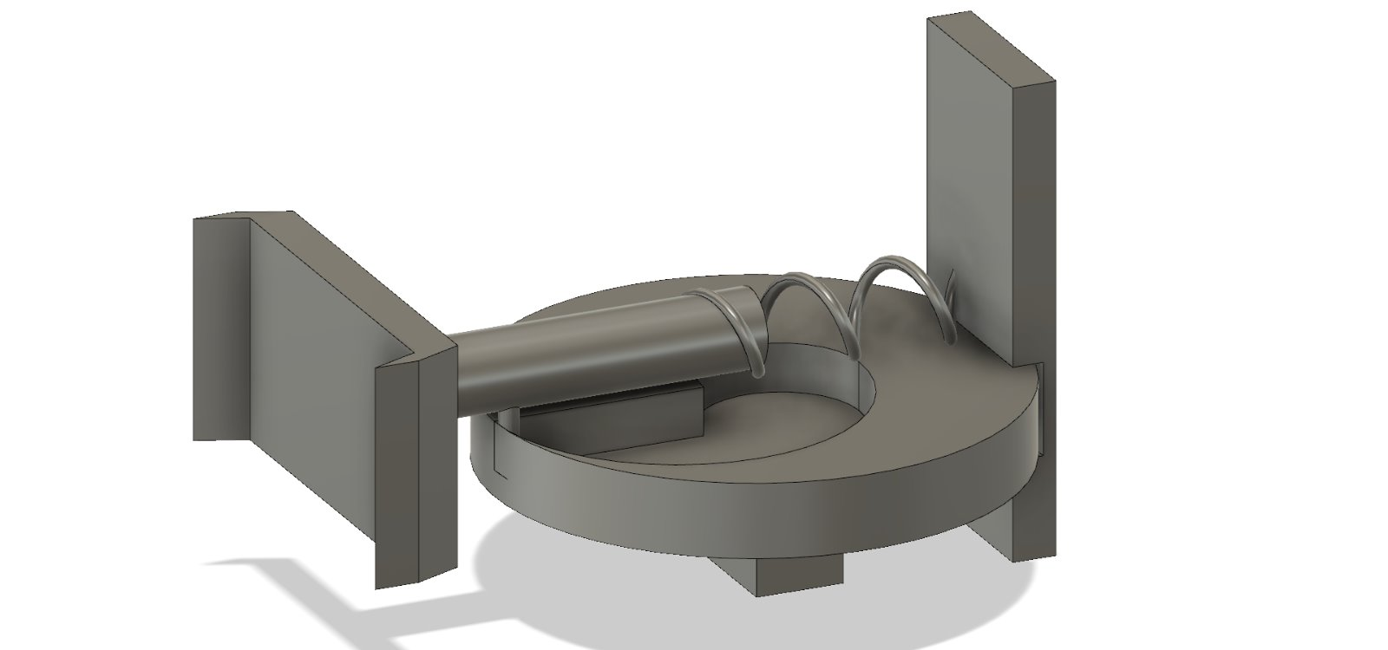
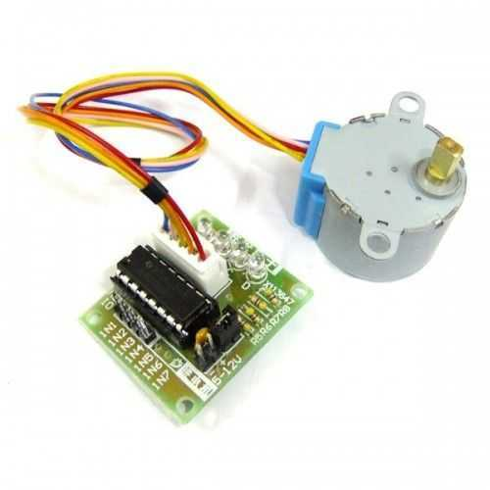
Shooting Mechanism

Slide 6
Actuator System
Objectives&Requirements
Agile Movement
Durability (in Power Aspect)
Inexpensive

Slide 7
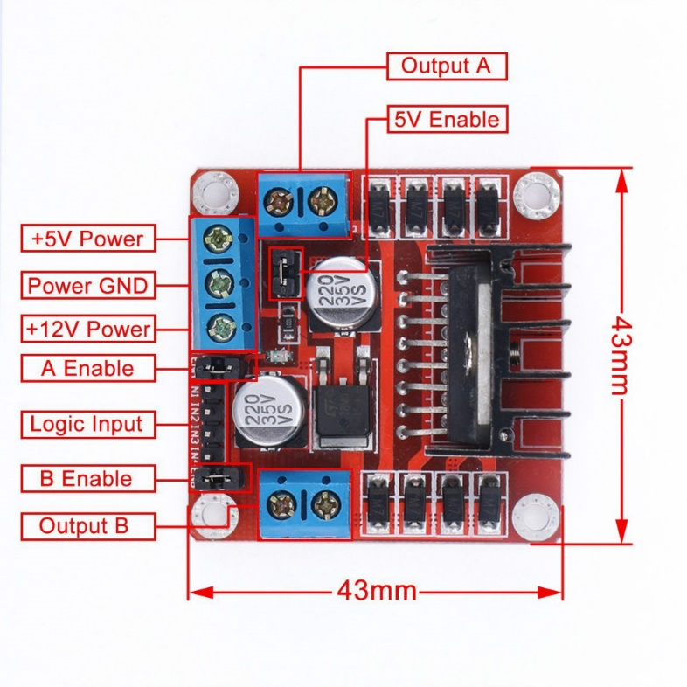
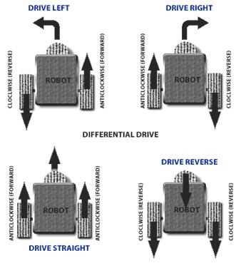
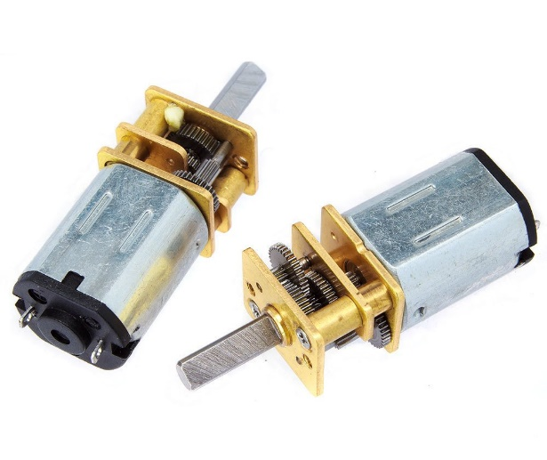
Agile Movement

Slide 8
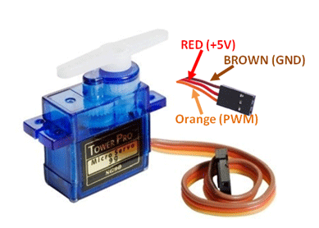
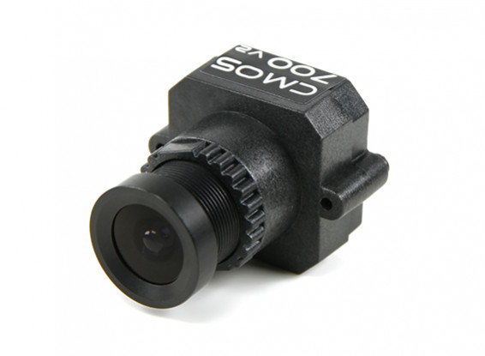
Camera Movement

Slide 9
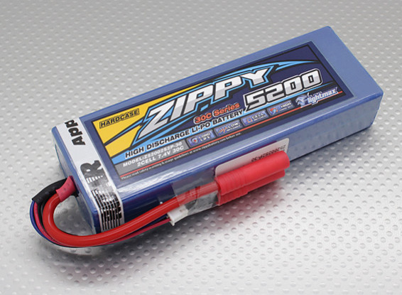
Power
5200maH
Li-Po
2Cell 7.4V
30C

Slide 10

Power Analysis of Robot
Component | Power Consumption
Shooting Mechanism | 0.45W (One shot)
Camera Movement | 0.42W (Continous Rotation)
Camera | 1W
Transmitter | 3.5W
Motor Movement | 4.8W
Reciever | 0.2W
Total | 10.37W
Battery Capacity | 38.5 Wh
Time = Battery Capacity/ Total = 4 Hours

